Slide 1
Carbohydrate Metabolism:
Pentose Phosphate Pathway
INTER 111: Graduate Biochemistry

Slide 2
PPP: learning objectives
Why is it said the pentose phosphate pathway is the major source of ‘reducing power’? What are the differences, in structure and in function, between NADH and NADPH?
Outline the pentose phosphate path, using glucose 6-phosphate, fructose 6-phosphate, glyceraldehyde 3-phosphate, ribose 5-phosphate, pyruvate, phosphoenolpyruvate, and oxaloacetate (not all compounds are needed to answer the question).
Be able to recognize the reactions catalyzed by transaldolases and transketolases. Know how they are involved in interconverting intermediates in the pentose phosphate pathway and glycolysis.
Why is the reversibility of transaldolase-catalyzed and transketolase-catalyzed reactions important in the linkage of the pentose phosphate shunt, glycolysis, and gluconeogenesis?
In which compartment of eukaryotic cells do gluconeogenesis and the pentose phosphate pathways occur? Understand why all of these reactions do not occur in the same compartment.
Be able to explain G6PD genotype, phenotype, and clinical observations.

Slide 3
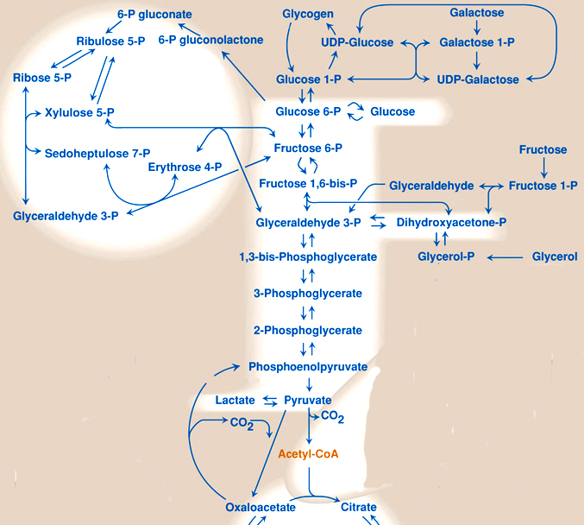
Overview of carbohydrate metabolism
PPP
glucose
Glucose
Glycolysis
NADH + H⁺
+
ATP
Gluconeogenesis
Pyruvate
pyruvate

Slide 4
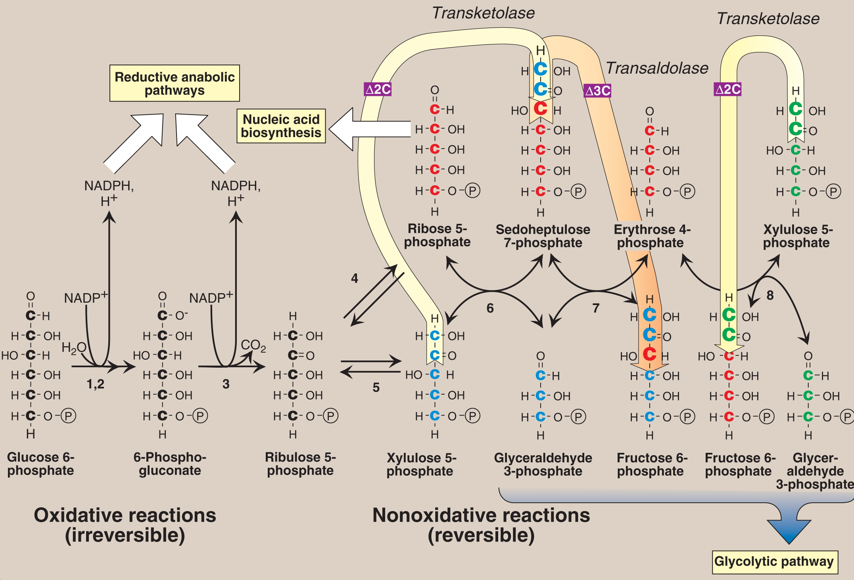
There are three major outcomes from the PPP pathway
Primary functions of pathway:
  provide ribose-5-phosphate (R5P) for the synthesis of the nucleotides and nucleic acids
  generate NADPH for reductive biosynthesis reactions within cells
    10% of NADPH production in humans
  rearrange the carbon skeletons of dietary carbohydrates into glycolytic/gluconeogenic intermediates

Slide 5
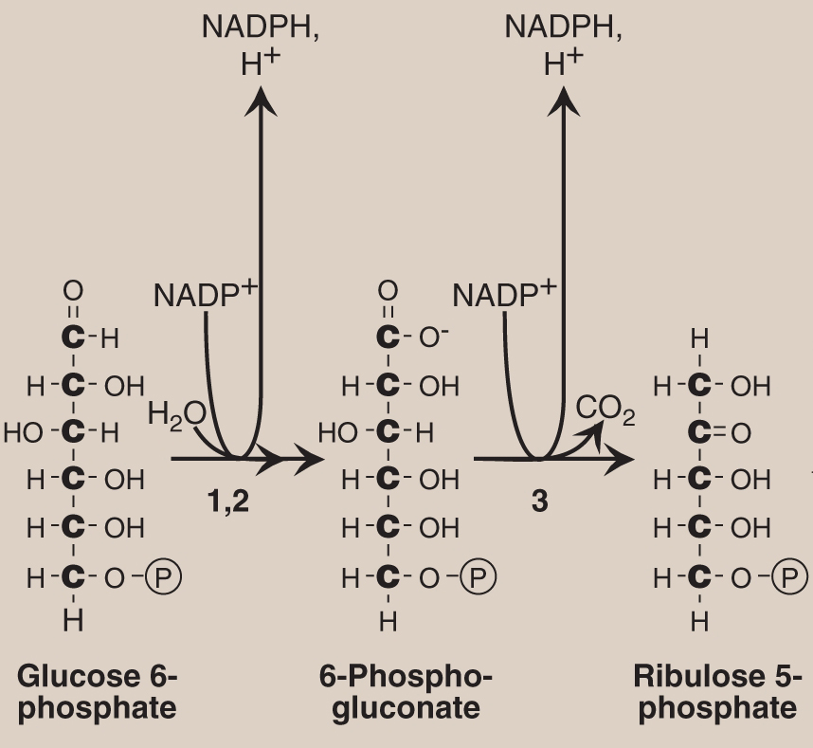
PPP: Irreversible oxidative rxns
Net result of three reactions in oxidative phase:

Slide 6
PPP: Irreversible oxidative rxns
Product of rxn 1 =
6-phosphogluconolactone
NADP⁺ coenzyme
NADPH?
NADPH
NADP⁺
If cellular ratio low?
Glucose 6-phosphate dehydrogenase (G6PD)
6-phosphogluconolactone hydrolyase
6-phospho-gluconolactone dehydrogenase

Slide 7
PPP: Irreversible oxidative rxns
Product of rxn 2 =
6-phosphogluconate
Glucose 6-phosphate dehydrogenase (G6PD)
6-phosphogluconolactone hydrolyase
6-phospho-gluconolactone dehydrogenase

Slide 8
PPP: Irreversible oxidative rxns
Glucose 6-phosphate dehydrogenase (G6PD)
6-phosphogluconolactone hydrolyase
6-phospho-gluconolactone dehydrogenase

Slide 9
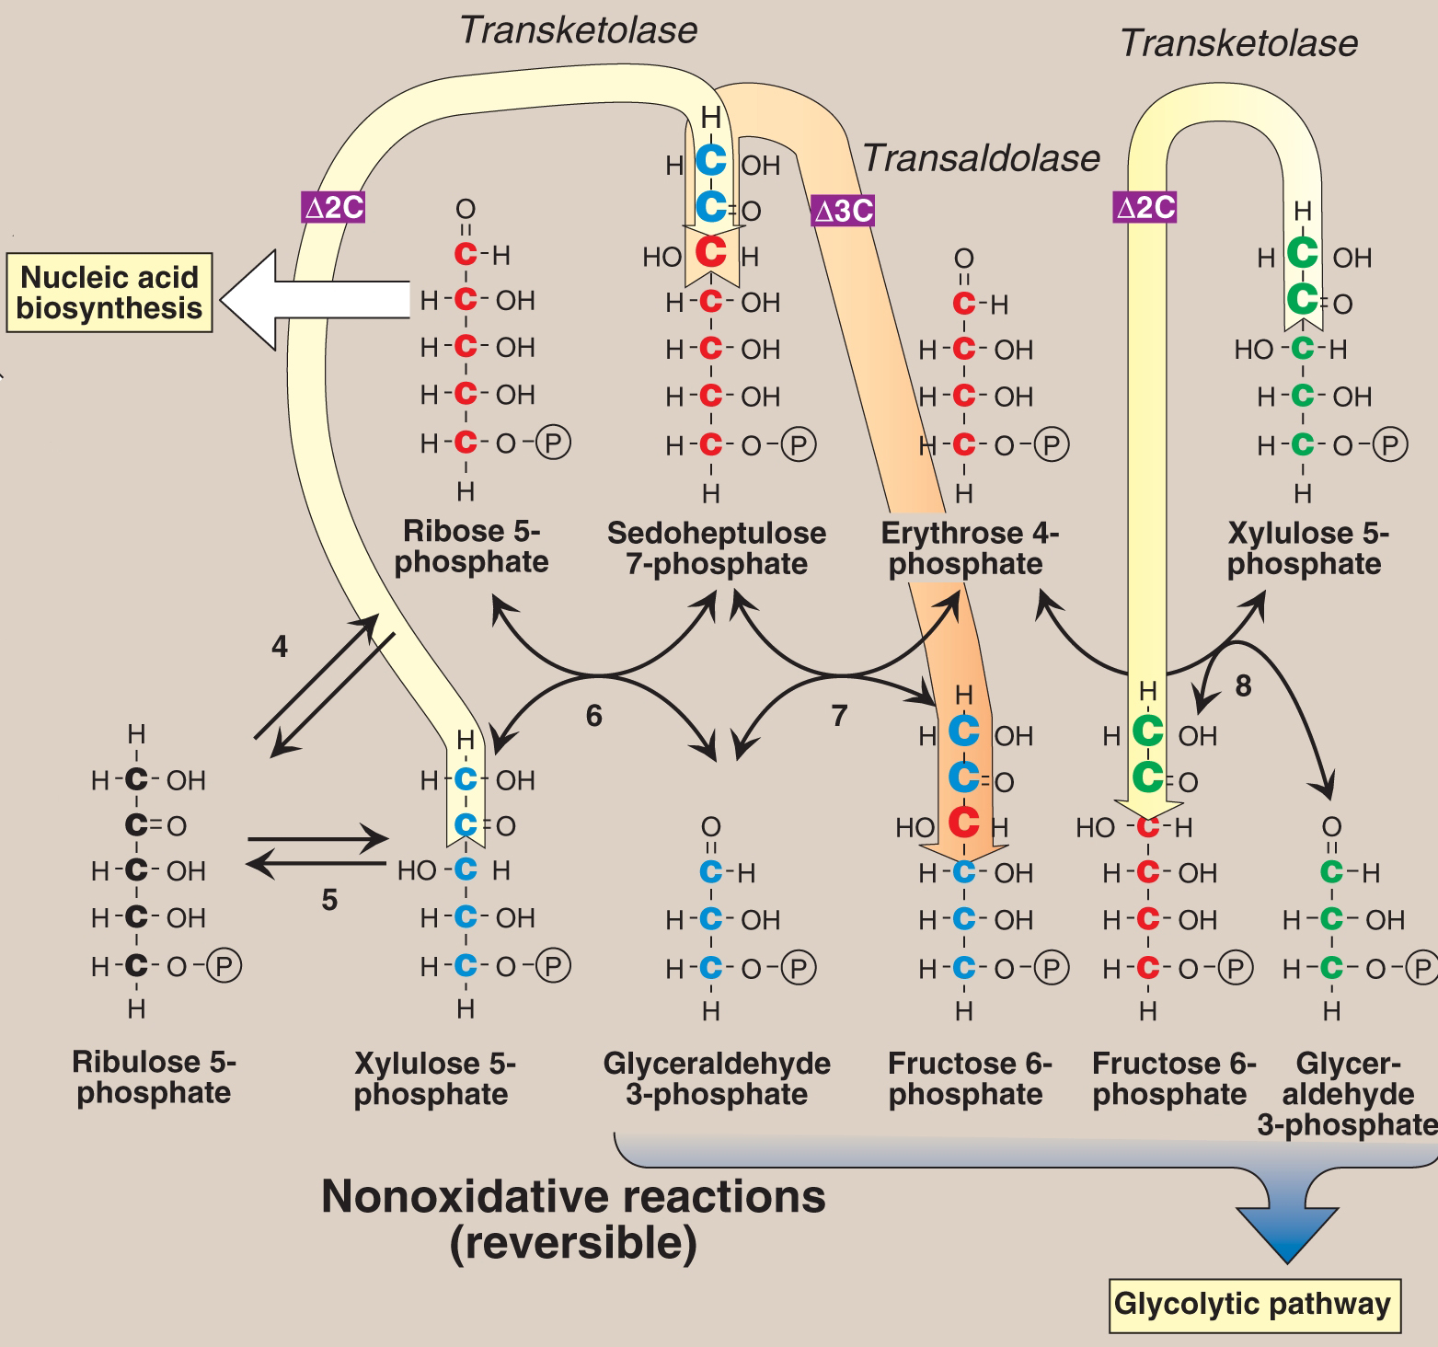
PPP: Non-oxidative rxns
(reversible)

Slide 10
PPP: Non-oxidative rxns
3-C
transfer rxn
2-C
transfer rxn

Slide 11
NADPH from oxidative PPP is used in anabolic reactions
  provide ribose-5-phosphate (R5P) for the synthesis of the nucleotides and nucleic acids
  generate NADPH for reductive biosynthesis reactions within cells
    10% of NADPH production in humans
  rearrange the carbon skeletons of dietary carbohydrates into glycolytic/gluconeogenic intermediates

Slide 12
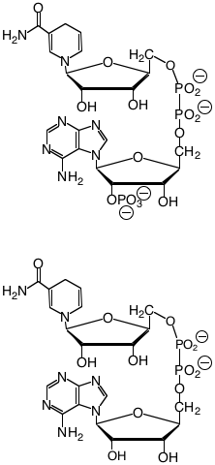
Nicotinamide cofactors
NADPH
Enzymes that function primarily in the reductive direction utilize the NADP⁺/NADPH cofactor pair
Oxidative enzymes utilize the NAD⁺/NADH cofactor pair.
NADP⁺ / NADPH ratio in hepatocytes ~0.1
NAD⁺ / NADH ratio is ~1000
NADH

Slide 13
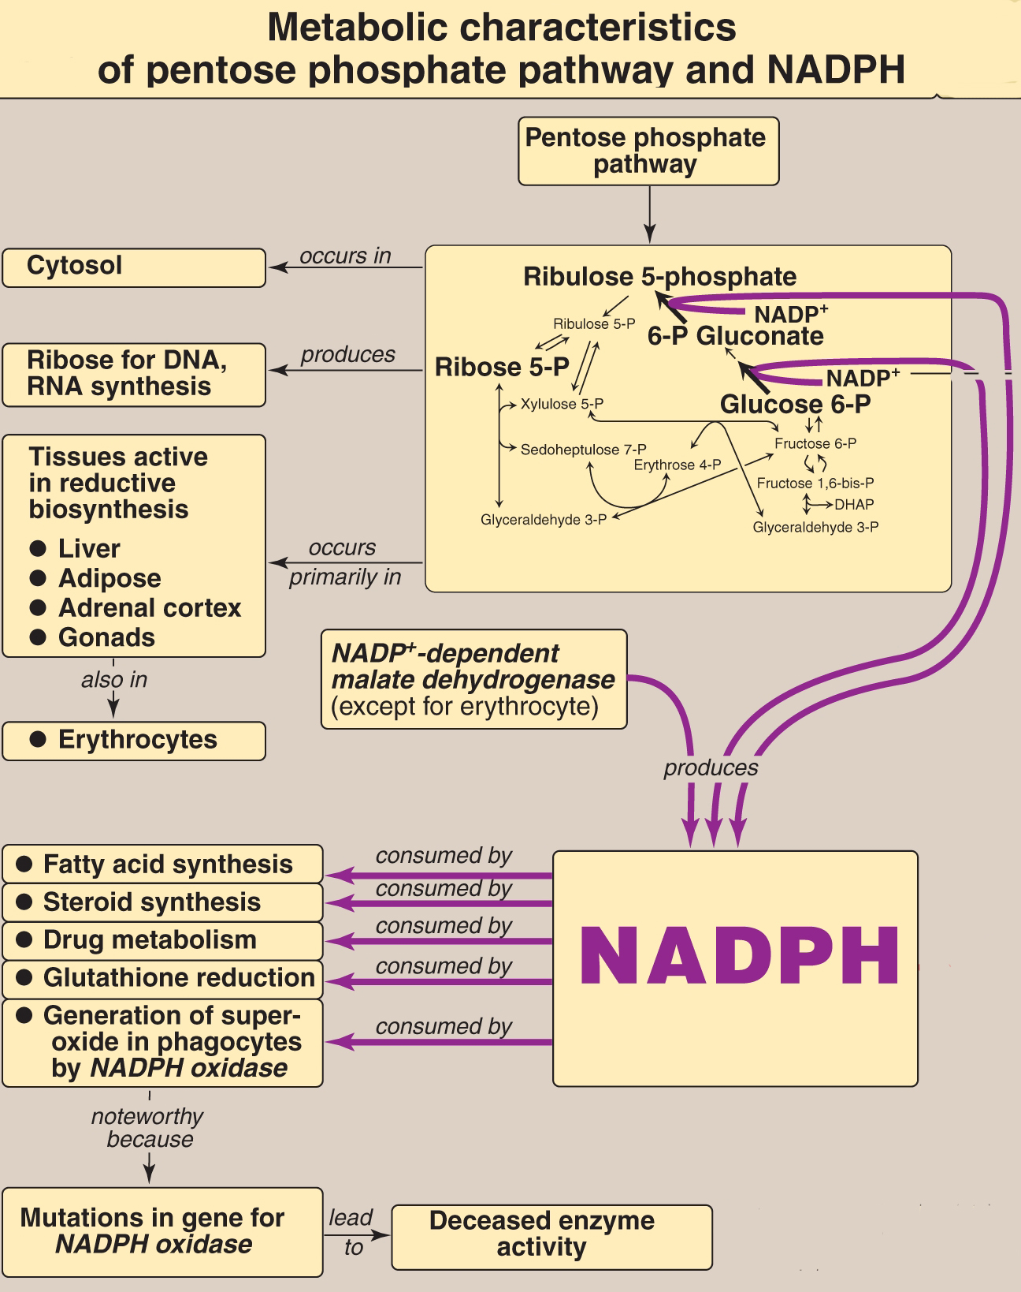
Synthesis
Fatty acid biosynthesis
Cholesterol biosynthesis
Neurotransmitter biosynthesis
Nucleotide biosynthesis
Detoxification
Cytochrome P₄₅₀ monooxygenases
Reduction of oxidized glutathione
White blood cell phagocytosis
Nitric oxide synthesis

Slide 14
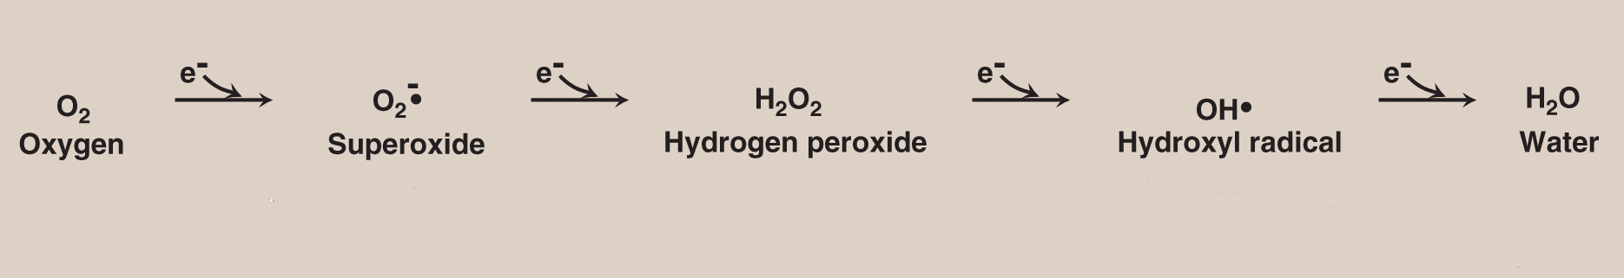
A family of reactive oxygen species form from O₂ reduction

Slide 15
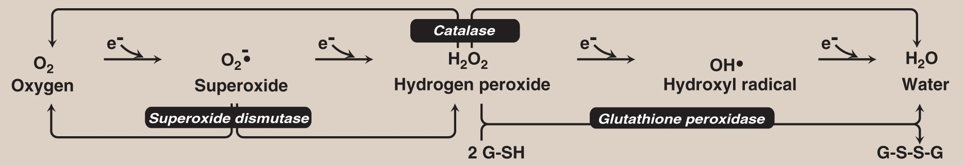
There are protective mechanisms against oxidative stress in the cell
(reduced)
(oxidized)
Superoxide dismutase and catalase catalyze conversion of
toxic oxygen intermediates to harmless products.
NADH is not used in these enzymes’ mechanism.

Slide 16
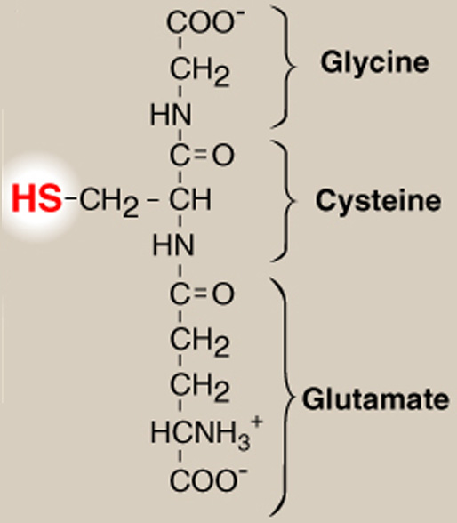
There are protective mechanisms against oxidative stress in the cell
v
(reduced)
(oxidized)
glutathione
reductase
NADP⁺
NADPH
+ H⁺
glutathione

Slide 17
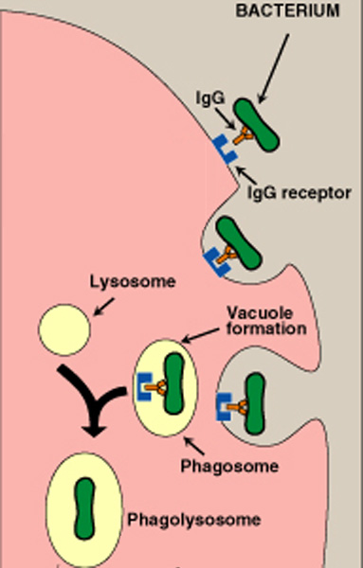
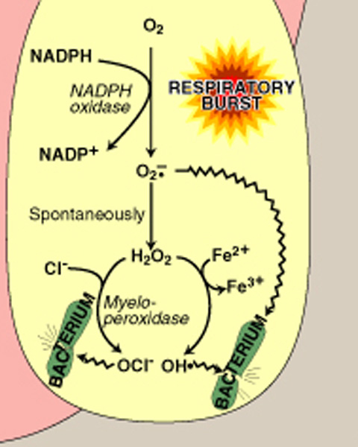
NADPH oxidase: microbial killing
Pathogen attachment & ingestion
Microbial destruction

Slide 18
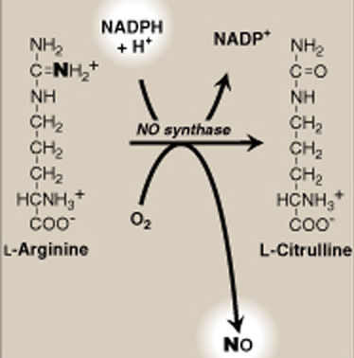
NADPH: nitric oxide synthesis
NO - free radical reactive with O₂ & superoxide
NO synthase
Has four cofactors
3 types of synthases identified

Slide 19
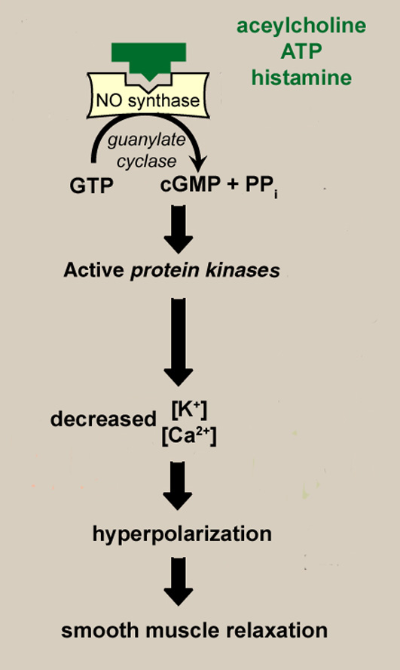
Arg
NO

Slide 20
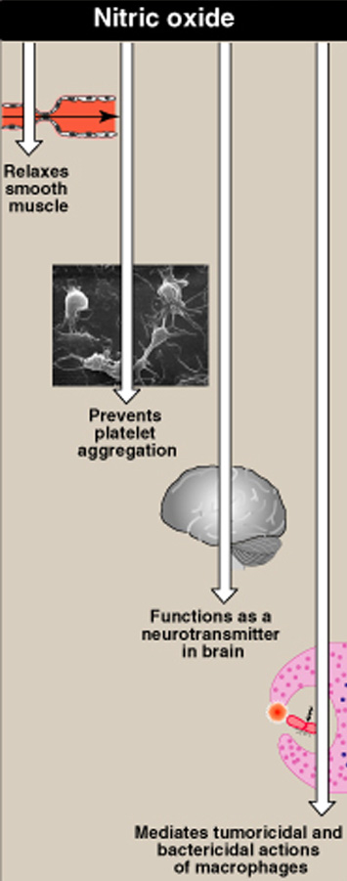
Consequences of smooth muscle relaxation:
  vasodilation
  bronchodilation
  postprandial stomach relaxation
Pharmaceutical targets for nitric oxide
NO synthesis inhibitors
NO antagonists
NO mimetics
  Increase NO synthesis by administration

Slide 21
PPP: Irreversible oxidative rxns
G6PD monomer consists of ~500 residues (59 kDa)
Glucose 6-phosphate dehydrogenase (G6PD)
6-phosphogluconolactone hydrolyase
6-phospho-gluconolactone dehydrogenase

Slide 22
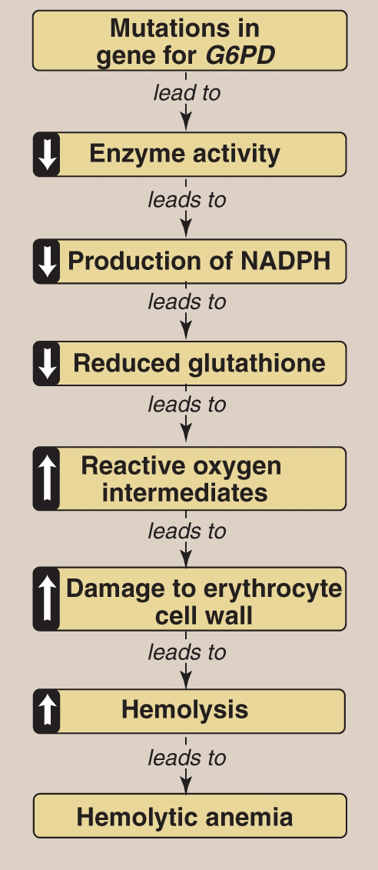
G6PD deficiency is a prevalent enzyme abnormality in humans (1956)
Populations in tropics/subtropics of Africa and Asia, Mediterranean, and Middle East
X-linked inherited condition

Slide 23
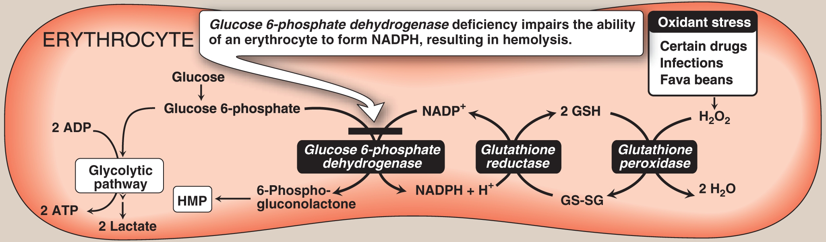
Inborn errors in CHO metabolism
PPP

Slide 24
Oral intakes to avoid
Dietary
  Fava beans
  Red wine
  Blueberries
  Soy products
  Tonic water
Chinese Herbs
  Cattle Gallstone Bezoar (Bos Taurus Domesticus)
    Commonly used to treat fainting, mental disorders, convulsions, high fever, and all forms of hot, red swellings
    Influences heart and liver
  Honeysuckle (Lonicera japonica)
    Commonly used to treat painful urination, fever, sore throat, headache, sores, swellings, and abcesses
    Influences large intestine, lung, and stomach
  Chimonanthus flower (Chimonanthus praecox)
    Commonly used to treat fever, sore throat, and painful eye problems
    Also used to treat last stage of measles
    Influences liver, lung, neutralizes heat-toxins, and activates blood and circulation
  Pearl powder
    Used to clear excess heat, settle frequent, fitful dreams
    Applied externally for mild acne and to promote clear and clean complexion
Drugs
  Primaquine
  Sulphonamide antibiotics
  Nitrofurantoin
  Vitamin K analogues

Slide 25
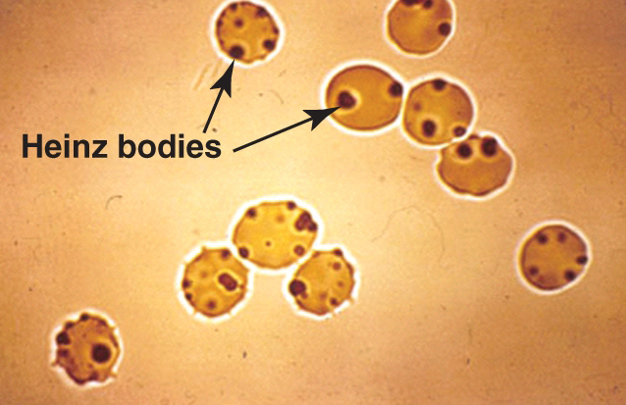
G6PD deficiency
Common clinical manifestations
  Asymptomatic (if offending agents avoided)
  Neonatal jaundice
  Acute hemolytic anemia
    Sudden rise in body temperature
    Dark yellow-orange urine
    Pallor, fatigue, general deterioration of physical conditions
    Heavy, fast breathing
    Weak, rapid pulse

Slide 26
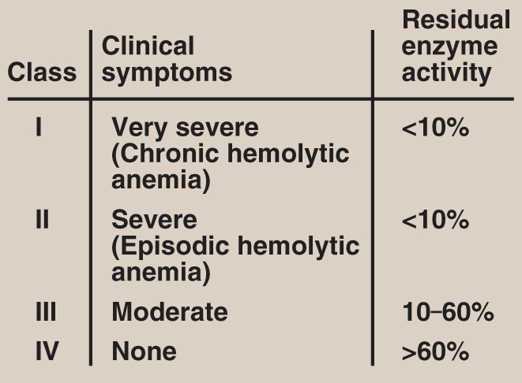
G6PD deficiency can be caused by 400 different point mutations

Slide 27
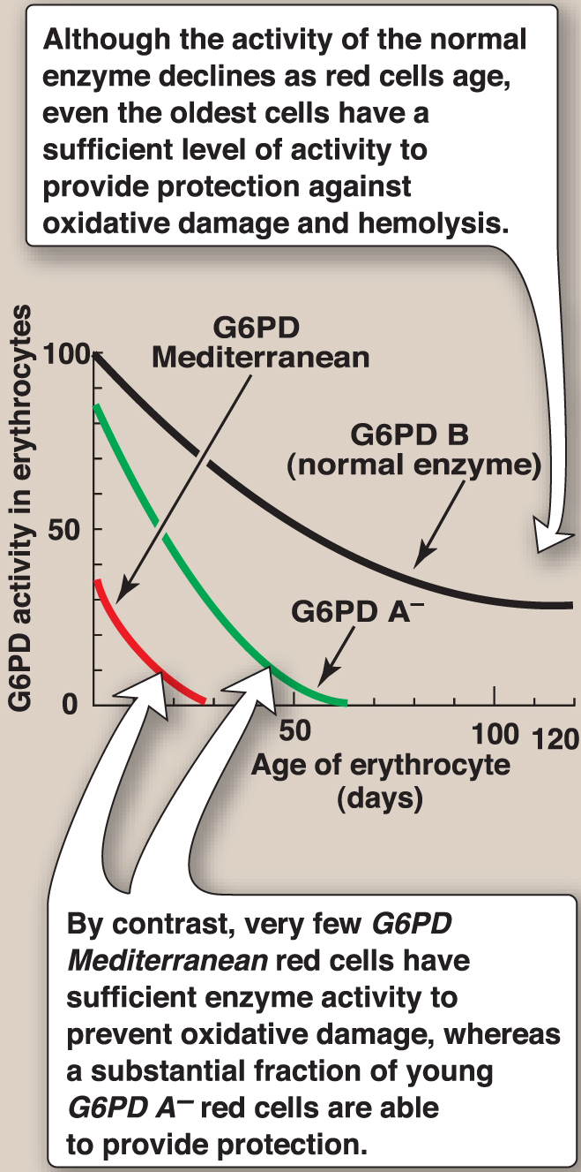
Erythrocyte G6PD activity declines with cell age for the three most common forms of the enzyme

Slide 28
By what means can G6PD point mutations disrupt function?

Slide 29
G6PD deficiency
Genomic and structural information at the biochemical level critical for understanding disease

Slide 30
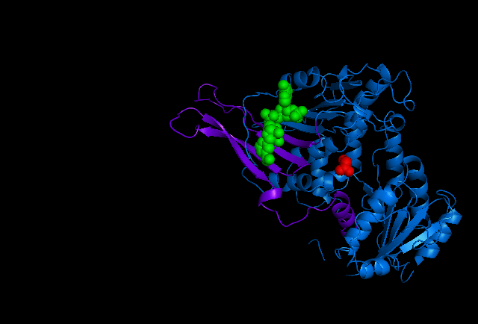
active site at amino end
cofactor binding site at carboxy end
Au et al. (2000) Structure 8, 826
Human G6PD monomer

Slide 31
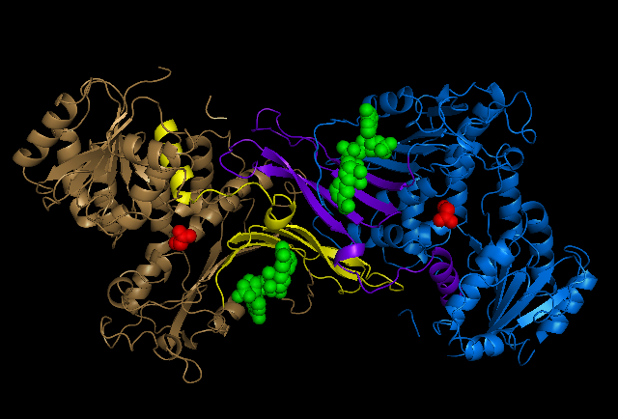
Human G6PD dimer
Au et al. (2000) Structure 8, 826

Slide 32
Human G6PD dimer
Class I mutations are altered residues 362-446
Mutations at N-terminus are not deleterious
Au et al. (2000) Structure 8, 826

Slide 33
G6PD deficiency is suspected if jaundice & anemia occur
Diagnosis
Full blood count and reticulocyte count
Beutler fluorescent spot test
protein electrophoresis to confirm diagnosis
Direct DNA testing and/or sequencing of G6PD gene

Slide 34
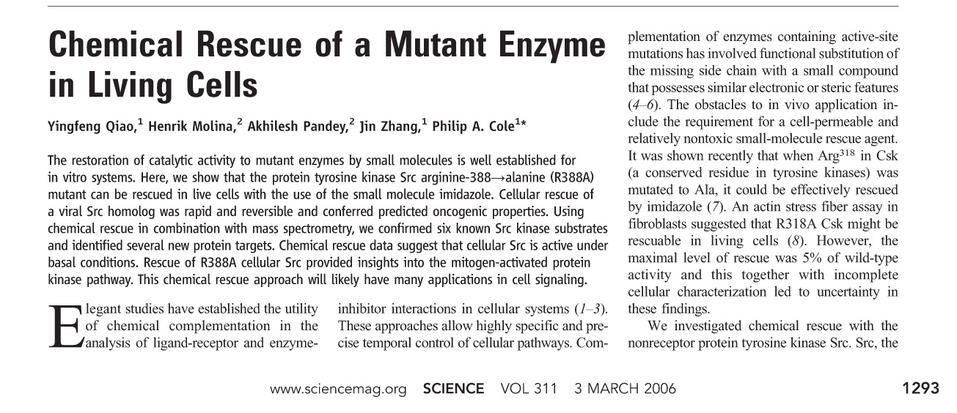
Can G6PD deficiency be cured?
  Short-term treatments for hemolytic anemia include blood transfusion
  No long term treatment for genetic defect

